Slide 1


COMPRADORES
EDOMEX
AGOSTO 2021
www.amdamex.mx
Notes:
Bienvenida

Slide 2


Slide 8
IMPACTO ECONÓMICO EN LA CONTINGENCIA ($, miles de pesos)
MES | UNIDADES | $ PROMEDIO | DERRAMA $ | IVA | ISAN
mar-20 | - 3,336 | 309 | - 1,032,421 | - 142,403 | - 72,269
abr-20 | - 7,541 | 309 | - 2,333,780 | - 321,901 | - 163,365
may-20 | - 6,846 | 309 | - 2,118,692 | - 292,233 | - 148,308
jun-20 | - 4,588 | 309 | - 1,419,894 | - 195,847 | - 99,393
jul-20 | - 3,346 | 309 | - 1,035,520 | - 142,830 | - 72,486
ago-20 | - 1,979 | 309 | - 612,461 | - 84,477 | - 42,872
sep-20 | - 1,982 | 309 | - 613,389 | - 84,605 | - 42,937
oct-20 | - 2,085 | 309 | - 645,266 | - 89,002 | - 45,169
nov-20 | - 2,919 | 309 | - 903,372 | - 124,603 | - 63,236
dic-20 | - 3,080 | 309 | - 953,198 | - 131,476 | - 66,724
ene-21 | - 3,121 | 309 | - 965,888 | - 133,226 | - 67,612
feb-21 | - 3,352 | 309 | - 1,037,379 | - 143,087 | - 72,617
mar-21 | 131 | 309 | 40,542 | 5,592 | 2,838
abr-21 | 5,490 | 309 | 40,542 | 5,592 | 2,838
may-21 | 5,176 | 309 | 1,601,862 | 220,947 | 112,130
CRISIS SANITARIA | - 33,378 | 4,642 | - 11,988,316 | - 1,653,561 | - 839,182

Slide 9
COMPARATIVO
POR
ESTADOS

Slide 13
COMPRADORES POR LOCALIDADES
EDOMEX

Slide 21
COMPRADORES POR LOCALIDADES EDOMEX ACUMULADO Agosto 2021
 | SUB | COMPACTOS | LUJO | DEPORTIVO | U. MULTIPLES | CAMIONES | ACUM.2021 | ACUM.2020 | DIF. | %
ACOLMAN | 149 | 94 | 6 | 2 | 114 | 31 | 396 | 310 | 86 | 21.7%
A DE JUÁREZ | 108 | 77 | 3 | 3 | 45 | 30 | 266 | 266 | - | 0.0%
ATENCO | 55 | 36 | 2 | 1 | 28 | 20 | 142 | 106 | 36 | 25.4%
ATIZAPÁN | 1,423 | 740 | 408 | 58 | 1,605 | 330 | 4,564 | 3,399 | 1,165 | 25.5%
CALIMAYA | 81 | 52 | 50 | 2 | 115 | 24 | 324 | 229 | 95 | 29.3%
CAPULHUAC | 24 | 19 | 2 | 3 | 21 | 14 | 83 | 80 | 3 | 3.6%
CHALCO | 438 | 372 | 7 | 4 | 328 | 72 | 1,221 | 1,034 | 187 | 15.3%
CHAPULTEPEC | 23 | 13 |  |  | 12 | 1 | 49 | 31 | 18 | 36.7%
CHIAUTLA | 37 | 23 | 3 | 1 | 35 | 11 | 110 | 82 | 28 | 25.5%
CHICOLOAPAN | 235 | 126 | 1 | 3 | 155 | 22 | 542 | 448 | 94 | 17.3%
CHICONCUAC | 22 | 12 | 4 | 2 | 41 | 14 | 95 | 67 | 28 | 29.5%
CHIMALHUACÁN | 425 | 247 | 5 | 7 | 223 | 68 | 975 | 863 | 112 | 11.5%
COACALCO | 712 | 371 | 56 | 15 | 491 | 91 | 1,736 | 1,619 | 117 | 6.7%
CUAUTITLÁN | 323 | 182 | 22 | 8 | 244 | 59 | 838 | 722 | 116 | 13.8%
C IZCALLI | 1,724 | 956 | 188 | 44 | 2,090 | 876 | 5,878 | 5,163 | 715 | 12.2%
ECATEPEC | 2,415 | 1,463 | 95 | 45 | 1,734 | 439 | 6,191 | 5,443 | 748 | 12.1%
HUIXQUILUCAN | 501 | 367 | 340 | 22 | 1,099 | 216 | 2,545 | 1,802 | 743 | 29.2%
IXTAPALUCA | 641 | 442 | 21 | 15 | 523 | 112 | 1,754 | 1,507 | 247 | 14.1%
JALTENCO | 29 | 21 |  | 1 | 24 | 1 | 76 | 75 | 1 | 1.3%
LA PAZ | 261 | 173 | 3 | 4 | 200 | 61 | 702 | 637 | 65 | 9.3%
LERMA | 288 | 184 | 29 | 5 | 238 | 110 | 854 | 625 | 229 | 26.8%
M OCAMPO | 103 | 48 | 1 | 1 | 60 | 16 | 229 | 221 | 8 | 3.5%
METEPEC | 584 | 374 | 226 | 19 | 873 | 188 | 2,264 | 1,764 | 500 | 22.1%
MEXICALTZINGO | 12 | 16 | 2 | 2 | 10 | 13 | 55 | 42 | 13 | 23.6%
NAUCALPAN | 2,163 | 1,835 | 532 | 52 | 2,674 | 998 | 8,254 | 6,950 | 1,304 | 15.8%
NEZAHUALCÓYOTL | 1,774 | 1,091 | 96 | 62 | 1,455 | 253 | 4,731 | 3,700 | 1,031 | 21.8%
N ROMERO | 475 | 279 | 16 | 5 | 310 | 96 | 1,181 | 1,135 | 46 | 3.9%
NO CONURBADO | 2,053 | 1,570 | 152 | 41 | 1,753 | 1,300 | 6,869 | 5,904 | 965 | 14.0%
OCOYOACAC | 74 | 48 | 19 | 4 | 66 | 24 | 235 | 211 | 24 | 10.2%
OTZOLOTEPEC | 42 | 21 | 1 |  | 33 | 14 | 111 | 117 | - 6 | -5.4%
S M ATENCO | 125 | 101 | 23 | 2 | 130 | 80 | 461 | 380 | 81 | 17.6%
TECÁMAC | 831 | 536 | 62 | 17 | 623 | 135 | 2,204 | 1,831 | 373 | 16.9%
TEJUPILCO | 24 | 43 | 7 |  | 51 | 35 | 160 | 114 | 46 | 28.8%
TEPOTZOTLÁN | 185 | 65 | 10 | 3 | 107 | 53 | 423 | 363 | 60 | 14.2%
TEXCOCO | 318 | 277 | 31 | 10 | 373 | 109 | 1,118 | 967 | 151 | 13.5%
TEZOYUCA | 30 | 27 | 4 | 2 | 29 | 17 | 109 | 115 | - 6 | -5.5%
TIANGUISTENCO | 70 | 55 | 8 | 1 | 51 | 35 | 220 | 151 | 69 | 31.4%
TLALNEPANTLA | 2,080 | 1,081 | 272 | 61 | 2,217 | 1,236 | 6,947 | 6,611 | 336 | 4.8%
TOLUCA | 2,225 | 1,722 | 434 | 50 | 1,927 | 1,685 | 8,043 | 5,510 | 2,533 | 31.5%
TULTEPEC | 216 | 104 | 9 | 2 | 148 | 44 | 523 | 470 | 53 | 10.1%
TULTITLÁN | 923 | 498 | 41 | 21 | 659 | 227 | 2,369 | 2,154 | 215 | 9.1%
V DE CHALCO | 265 | 196 | 5 | 6 | 161 | 55 | 688 | 650 | 38 | 5.5%
XONACATLÁN | 38 | 32 | 7 | 1 | 51 | 19 | 148 | 149 | - 1 | -0.7%
ZINACANTEPEC | 252 | 134 | 15 | 6 | 156 | 77 | 640 | 577 | 63 | 9.8%
EDOMEX | 22,046 | 13,900 | 2,647 | 535 | 19,717 | 8,045 | 66,890 | 64,594 | 2,296 | 3.4%

Slide 25
COMPRADORES POR MARCA
EDOMEX

Slide 26
COMPRADORES POR ESTADO POR MARCA ACUMULADO agosto 2021

Slide 27
EDOMEX VS NACIONAL PENETRACIÓN POR MARCA ACUMULADO agosto 2021

Slide 28
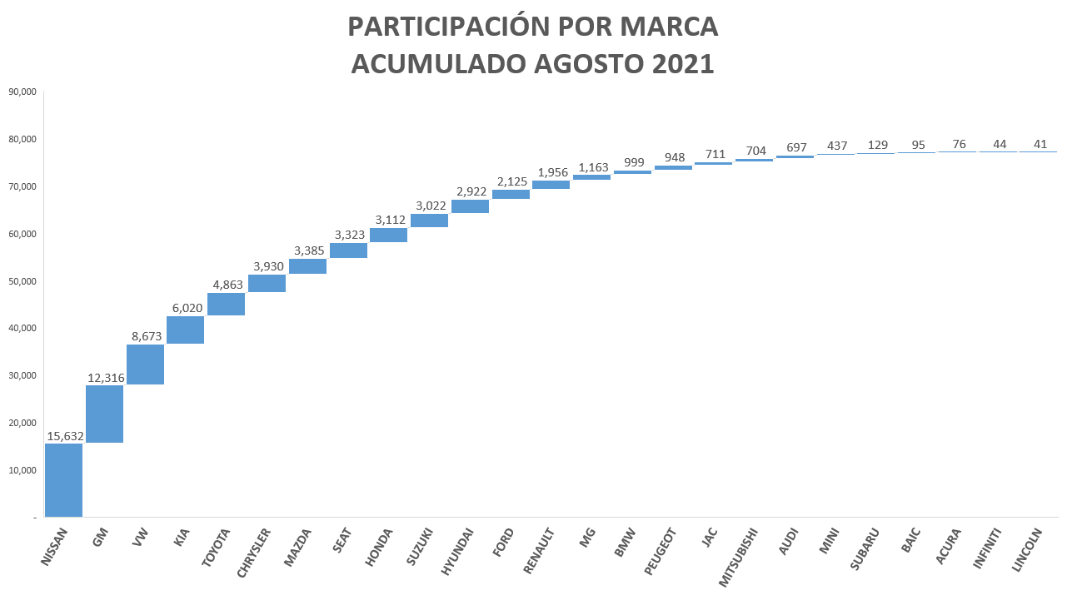

Slide 29
COMPRADORES POR MARCA POR LOCALIDAD ACUMULADO AGOSTO 2021

Slide 30
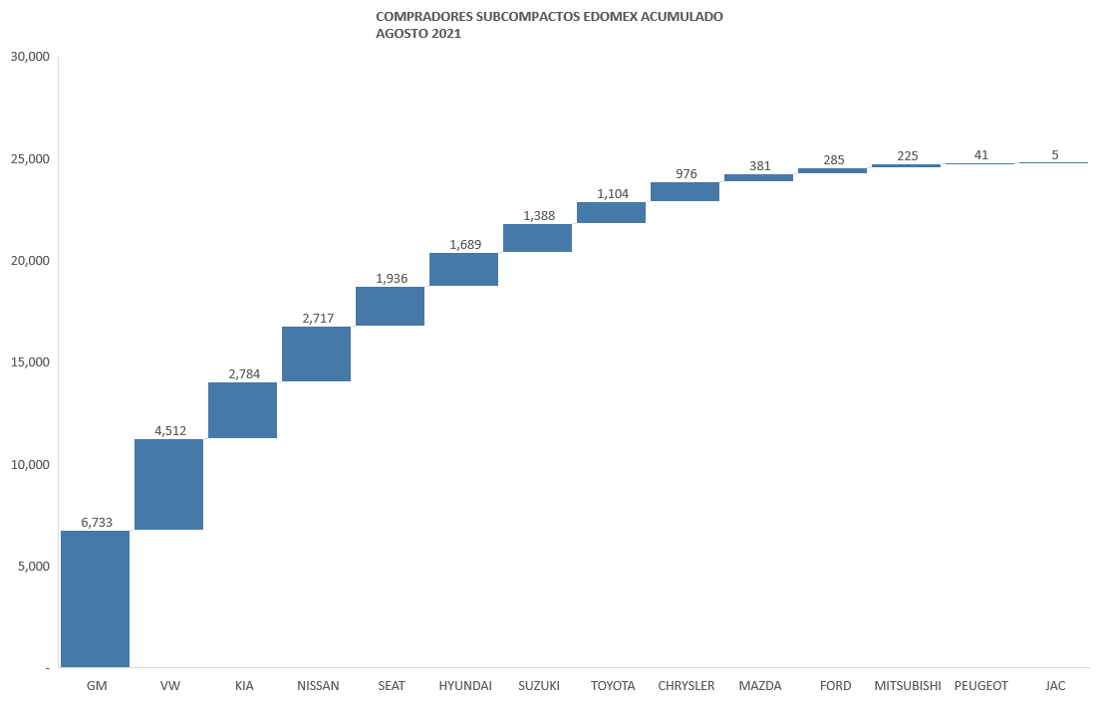

Slide 31
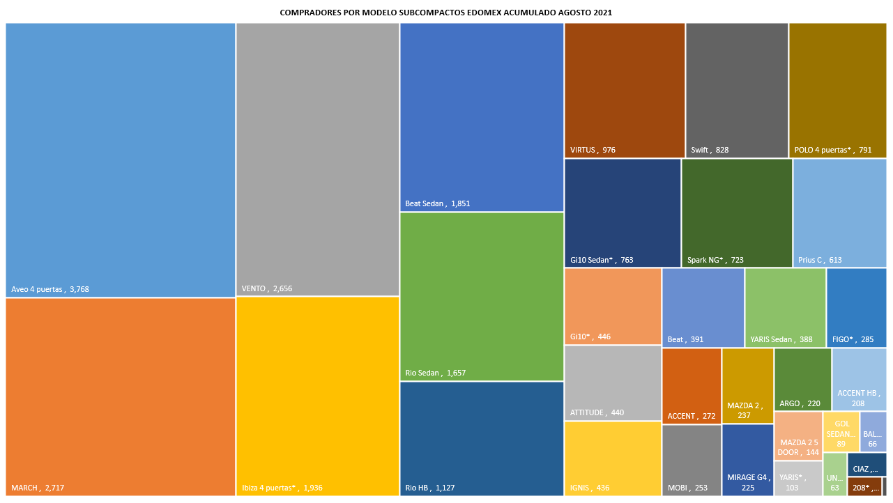

Slide 32

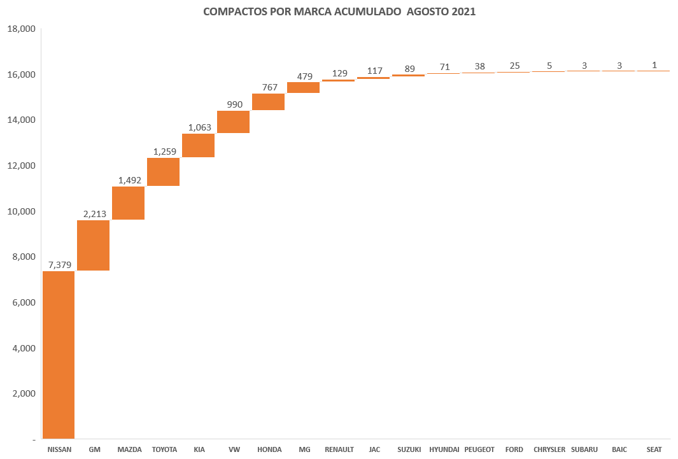

Slide 33
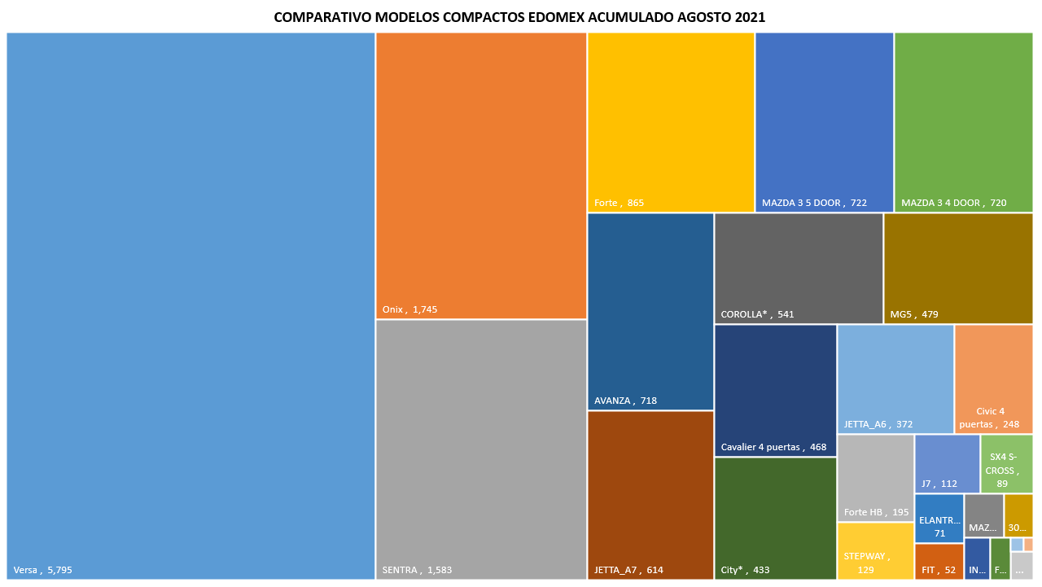

Slide 34

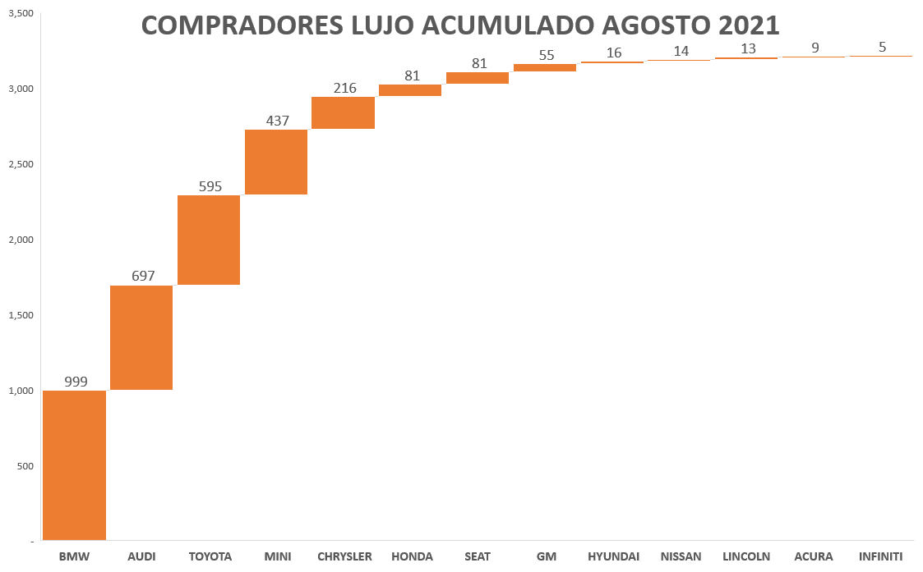

Slide 35
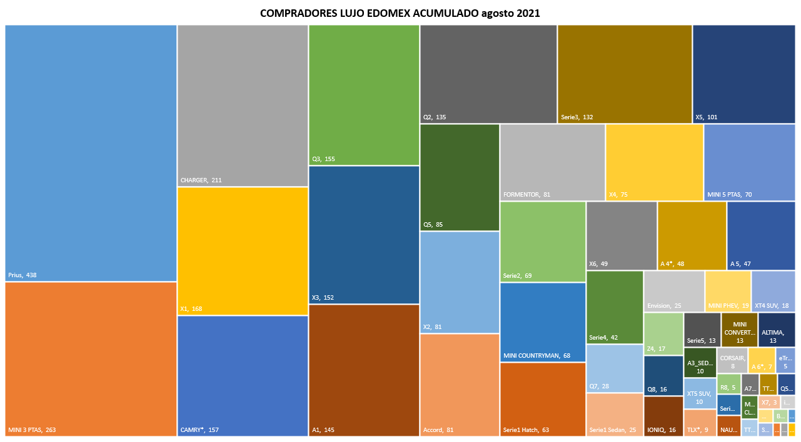

Slide 36
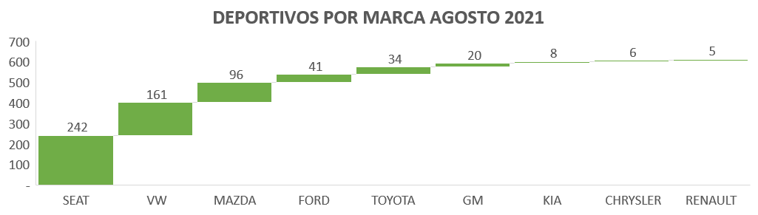
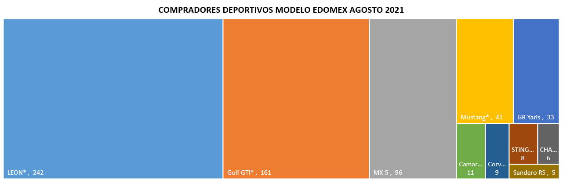

Slide 37
COMPRADORES MODELOS USOS MULTIPLES EDOMEX AGOSTO 2021
MODELOS USOS MULTIPLES |  |  |  | 23,282
KICKS | 1,166 | PROMASTER 2500 | 133 | Sei7 PRO | 25
Tracker | 1,147 | HIGHLANDER | 129 | Sunray | 25
HR_V | 1,093 | WRANGLER UNLIMITED | 122 | 5008 | 25
SELTOS | 1,023 | BRONCO SPORT | 122 | QX60 | 24
ERTIGA | 946 | Escape HEV | 109 | WRANGLER* | 23
CRETA | 875 | NIRO | 104 | OUTLANDER | 23
CAPTIVA SUV | 818 | Blazer | 100 | TRANSPORTER PASAJEROS | 23
KWID | 784 | Sei 2 | 99 | Yukon | 22
ARONA | 759 | CAPTUR | 99 | M50S | 20
Taos | 745 | Terrain | 90 | EXPEDITION* | 16
CR-V | 643 | Odyssey | 90 | Traverse SUV | 16
TCross | 628 | 3008 | 88 | NAVIGATOR* | 16
RAV4* | 596 | TARRACO | 87 | EDGE | 14
SIENNA* | 541 | Encore | 77 | ESCAPE* | 14
DUSTER | 538 | Caddy | 71 | Trax | 14
TIGUAN* | 526 | TERAMONT | 71 | AVIATOR | 12
ZS | 524 | FORESTER | 68 | PACIFICA | 11
Sportage | 496 | Sei 3 | 67 | Escalade SUV | 11
CX-5 | 483 | CX-9 | 67 | Express Passenger Van | 11
CX-3 | 474 | Tahoe | 60 | QX80 | 11
XTRAIL | 472 | Sei 4 | 59 | MONTERO SPORT | 11
TRANSIT | 441 | KOLEOS | 59 | TRANSIT COURIER | 10
BR_V | 398 | RDX | 58 | MDX | 9
CX-30 | 392 | EXPLORER SPORT TRAC | 58 | X35 | 9
VITARA | 380 | SUBARU XV | 58 | Sei 7 | 9
NV350 URVAN | 363 | ACADIA | 53 | PATHFINDER | 9
Soul | 347 | HIACE Pasajeros | 50 | X25 | 7
TUCSON* | 264 | Escalade ESV | 49 | SANTA FE | 7
PROMASTER RAPID | 231 | COMPASS | 48 | PROMASTER 3500 | 5
JIMNY | 219 | DURANGO* | 48 | E Sei 4 | 5
ATECA | 217 | Expert Cargo Van | 48 | ECLIPSE CROSS | 5
RENEGADE | 216 | Yukon XL SUV | 46 | Sequoia | 5
TRANSPORTER CARGA* | 211 | ENCLAVE SUV AWD | 45 | BJ20 | 4
ECOSPORT* | 177 | Sedona | 43 | QX50 | 4
2008* | 162 | XPANDER | 42 | BJ40 | 3
HS | 160 | Pilot | 40 | X65 | 3
Sorento | 152 | Equinox | 36 | Express Cargo Van | 2
GRAND CHEROKEE | 145 | EXPLORER* | 31 | E Sei 2 | 2
RIFTER | 141 | Cross Sport | 30 | HIACE Ventanas | 2
Suburban | 137 | X30 | 29 | TRAVELLER | 1
 |  |  |  | LAND CRUISER* | 1

Slide 38


Slide 39
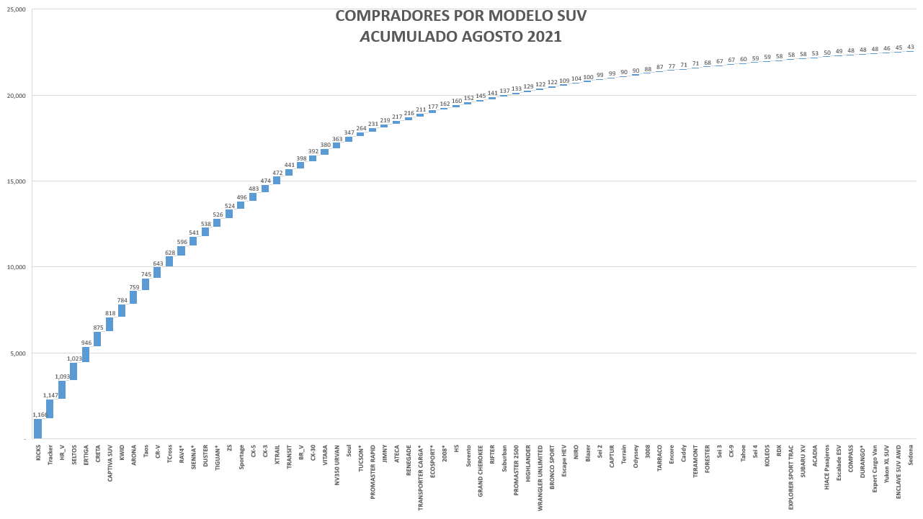


Slide 42
OBSERVACIONES
Fuente: Elaboración de AMDAMEX con base en Urban Science
Nota: Se refiere a información de compradores. No incluye información de Isuzu, Jaguar, Land Rover, Mercedes-Benz, Porsche y Volvo. Estas marcas se reflejan en "Otras Marcas"
La información de compradores se refiere a los registros de acuerdo a la plaza, ciudad o estado domicilio del comprador (cliente final).
La información de compradores se refiere a los registros de acuerdo a la plaza, ciudad o estado domicilio del comprador (cliente final).
El total nacional puede variar con respecto a publicación de INEGI debido a ajustes periódicos de la fuente.

